Slide 1

School of Computing
Vel Tech Rangarajan Dr. Sagunthala R&D Institute of Science and Technology
Department of Computer Science and Engineering
10211CS224 / FULL STACK APPLICATION DEVELOPMENT (JAVA)
PROJECT REVIEW : MILESTONE PROJECT – 2
Date: 17-04-2026
Design and develop a React JS based web application for Ticket Booking of an Internal Department Event
SDG: SDG 9 Industry, Innovation and Infrastructure
Presented By:
P.Sai Krishna– VTU25913- 23UECS0842
Courses Handling Faculty:
Dr.Hafizur Rahaman

Slide 2
INTRODUCTION
1
In today’s digital era, managing campus events such as workshops, seminars, and technical fests manually can be time-consuming, error-prone, and inefficient. Traditional methods like notice boards, manual registrations, and paper-based tracking often lead to poor communication, data loss, and difficulty in monitoring participation.
The Smart Campus Event Management System is a full-stack web application designed to automate and streamline the entire process of event management within a college or university. This system provides a centralized platform where students can easily explore upcoming events, register online, and provide feedback, while administrators can efficiently manage event details, monitor registrations, and analyze participation statistics.
The application is developed using modern technologies such as Spring Boot, Spring MVC, and Spring Data JPA for backend development, along with Thymeleaf, HTML5, and CSS3 for creating an interactive and user-friendly frontend. It follows a structured architecture with proper separation of concerns, ensuring scalability and maintainability.
2
3
4
5
6
7
8
9

Slide 3
PROBLEM STATEMENT
1
2
In many colleges and universities, the management of campus events such as workshops, seminars, and cultural activities is still handled using manual or semi-digital methods. Information about events is often shared through notice boards, emails, or messaging platforms, which can lead to miscommunication, missed updates, and limited student engagement. Additionally, event registration is frequently done through paper forms or unstructured online tools, making it difficult to maintain accurate records and track participation.
For administrators, managing multiple events becomes challenging due to the lack of a centralized system. Tasks such as creating events, updating schedules, handling registrations, and analyzing participation data are time-consuming and prone to errors. There is also limited capability to filter events or generate meaningful insights like registration statistics.
3
4
5
6
7
8
9

Slide 4
OBJECTIVE(S)
1
2
3
To design and develop a Smart Campus Event Management System that enables efficient creation, management, and organization of campus events through a user-friendly web interface for both students and administrators.
To implement a secure and automated event registration and tracking system that allows students to register easily and helps administrators monitor participation accurately and transparently.
To improve the overall event management process by reducing manual effort, minimizing errors, and enhancing accessibility through a centralized digital platform for managing events, registrations, and feedback.
4
5
6
7
8
9

Slide 5
PROPOSED SYSTEM
1
2
The proposed system is a web-based Smart Campus Event Management System that provides a centralized platform for managing all campus events efficiently.
It allows students to browse, register, and view upcoming events through an intuitive and user-friendly interface.
The system enables administrators to create, update, and delete events using secure login and role-based access control.
It includes automated registration management, ensuring accurate tracking of participants and eliminating manual errors.
The system provides advanced search and filtering options based on date, department, and event type for easy navigation.
It generates event participation statistics and feedback reports, helping administrators analyze and improve future events.
3
4
5
6
7
8
9

Slide 6
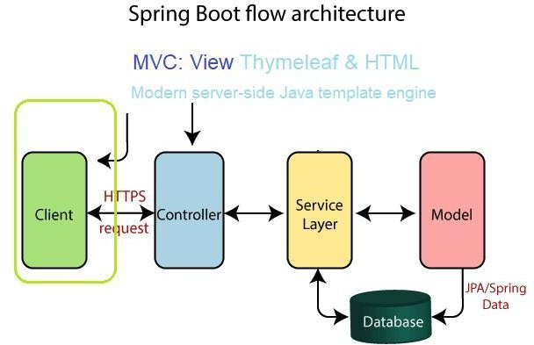
PROPOSED SYSTEM ARCHITECTURE
1
2
3
4
5
6
7
8
9

Slide 7
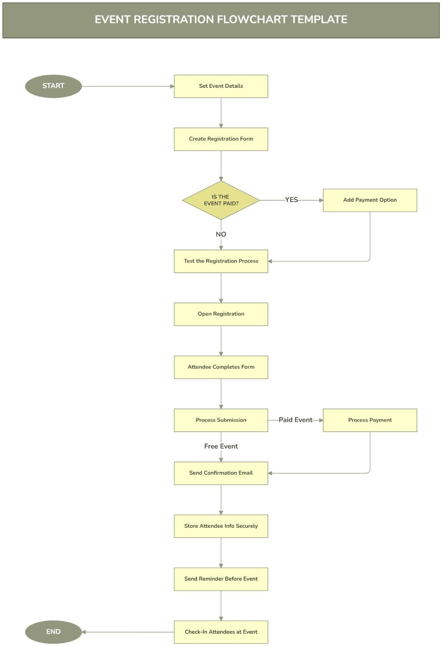
WORKFLOW
1
2
3
4
5
6
7
8
9

Slide 8
TECHNOLOGIES USED
1. Backend Technologies
Java – Core programming language for application logic
Spring Boot – For building standalone, production-ready applications with embedded server Spring MVC – For handling web requests using controllers (@Controller, @RestController) Spring Core – Dependency Injection using @Autowired
Spring Data JPA (Hibernate) – For database interaction and ORM (Object Relational Mapping)
1
2
3
2. Frontend Technologies HTML5 – Structure of web pages CSS3 – Styling and layout design
Thymeleaf – Template engine for dynamic content rendering
4
5
6
3. Database
MySQL (or H2 Database for testing) Used to store:
Event details Student information Registrations
Feedback
7
8
9
4. Validation & Security Java Bean Validation
@NotNull @Size
Spring Security (Basic Authentication)
Secure admin login
Role-based access control

Slide 9
MODULE DESCRIPTION
1
Module 1: User Management
Handles student and admin registration and login functionalities with secure authentication. It ensures role-based access control, where students can access event-related features and administrators can manage the system. This module maintains user data privacy and system security.
2
3
4
Module 2: Event Management (Core Processing)
Implements the core functionality of the system, including event creation, updating, and deletion by admins. It also allows students to browse events, register for events, and submit feedback. The module ensures smooth handling of event workflows and user interactions.
5
6
Module 3: Database Management
Responsible for storing and managing all system data such as event details, student information, registrations, and feedback. It ensures data consistency, integrity, and efficient retrieval using a structured database system like MySQL or H2.
7
8
9
Module 4: Reporting & Analytics
Generates reports on event participation, registration counts, and feedback analysis. It provides useful insights to
administrators, helping them evaluate event success and make better decisions for future events.

Slide 10
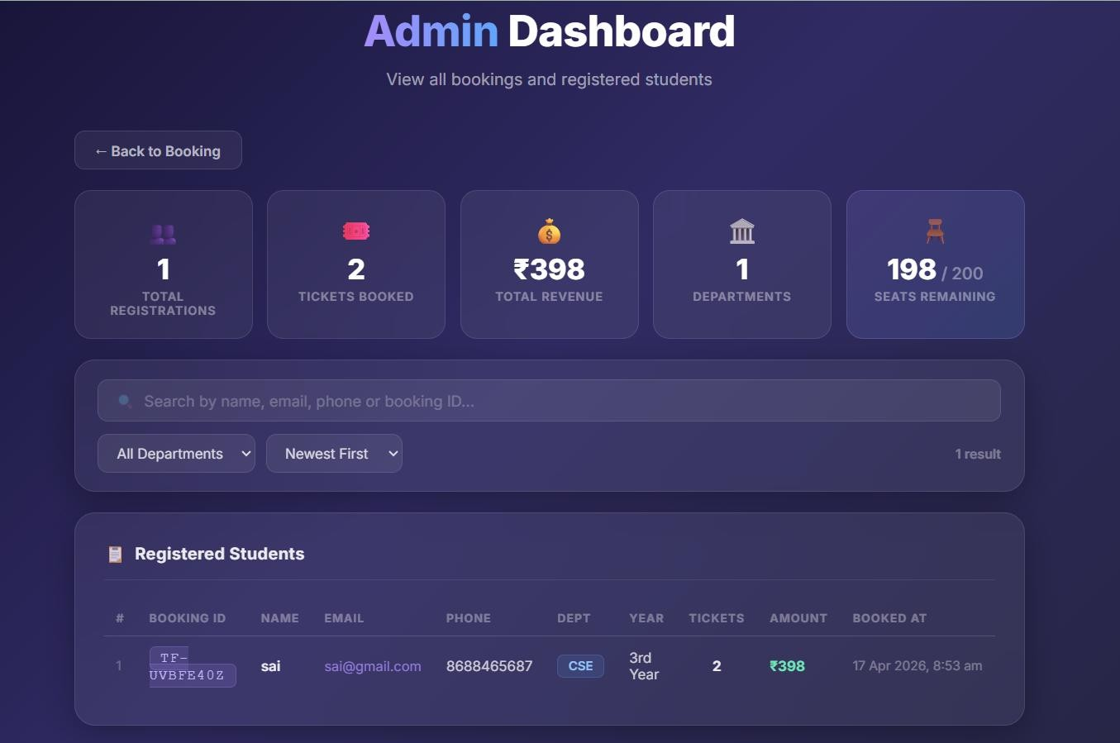
IMPLEMENTATION SCREENSHOTS
HOME PAGE FOR ADMIN
1
2
3
4
5
6
7
8
9

Slide 11
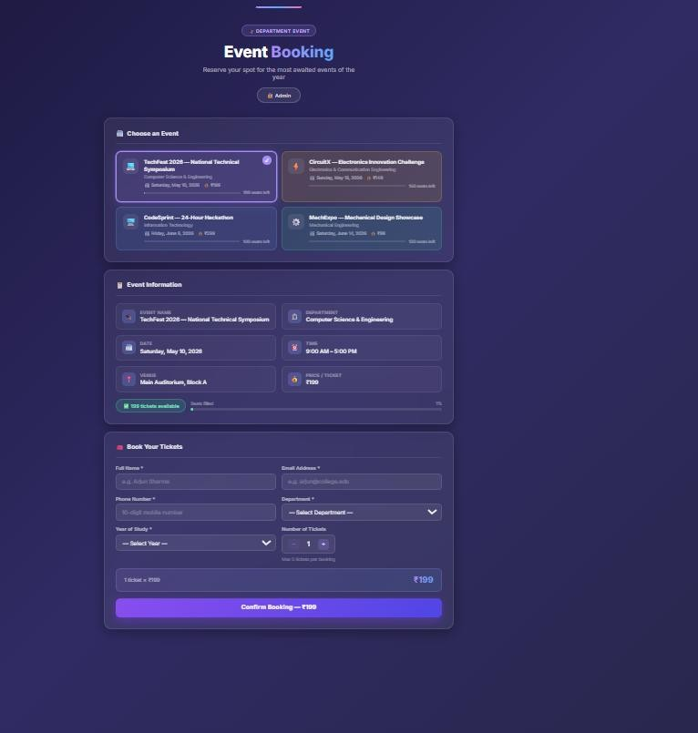
IMPLEMENTATION SCREENSHOTS
Dashboard:
1
2
3
4
5
6
7
8(B)
9

Slide 12
ADVANTAGES & LIMITATIONS
Advantages:
Centralized Management – All event-related activities (creation, registration, feedback) are handled in one platform, reducing confusion and duplication.
Time-Saving & Efficient – Automates event registration and management, minimizing manual work and speeding up processes.
User-Friendly Interface – Students can easily browse and register for events, improving participation and engagement.
Accurate Data Handling – Reduces human errors through automated validation and database management. Insightful Analytics – Provides reports and statistics on event participation, helping administrators make better decisions.
1
2
3
4
5
6
7
Limitations :
Internet Dependency – Requires stable internet access for both students and administrators.
Initial Setup Complexity – Development and configuration of the system may require technical expertise.
9 Security Risks – If not properly secured, the system may be vulnerable to unauthorized access or data breaches.
Limited Offline Access – Users cannot access features without being connected to the system online.
Maintenance Required – Needs regular updates and monitoring to ensure smooth performance and security.
8

Slide 13
Thank you

